Slide 1

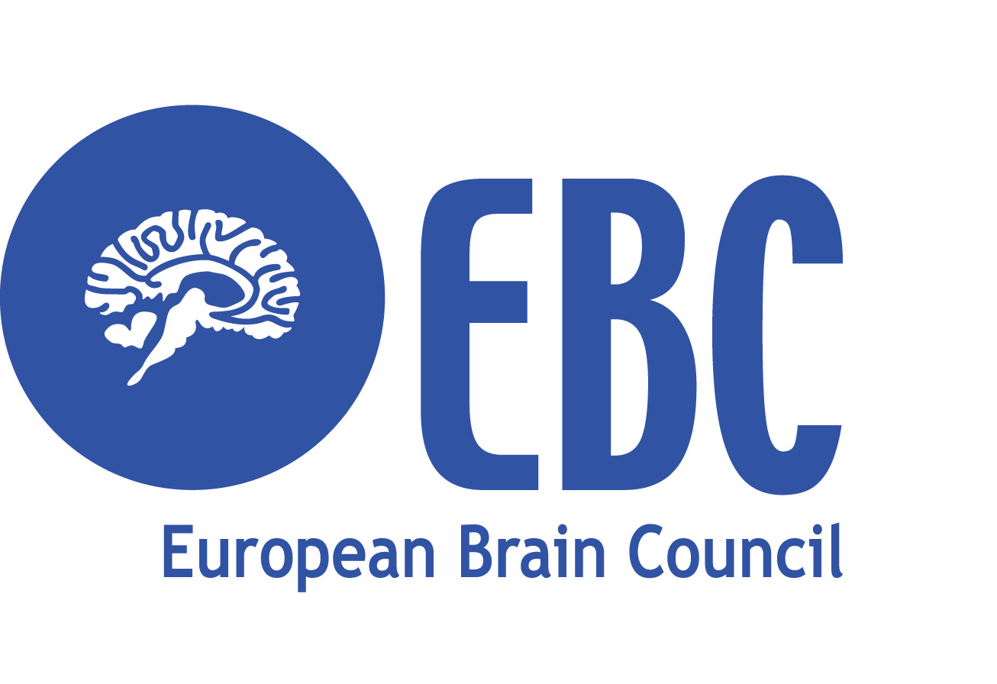

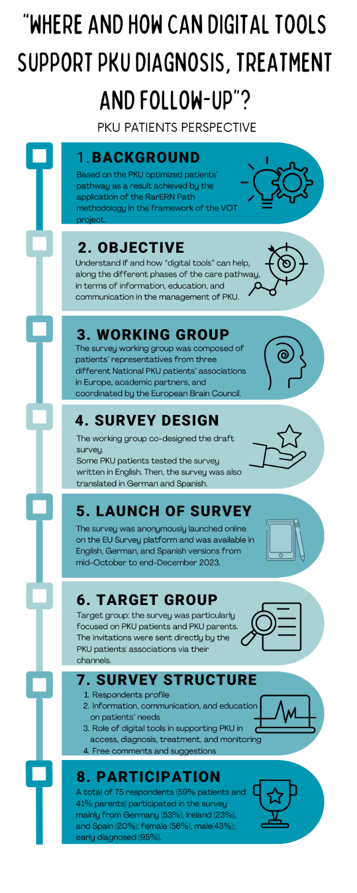
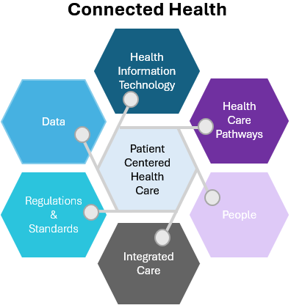




Assessing the Digital Care Pathways Unmet Needs for Rare Brain Diseases. The Case of Phenylketonuria
Cannizzo S₁, Quoidbach V₂, Treacy EP₃, Hermida A₄, MacDonald A₅, Scarpa M₆, Van Spronsen F₇, Lange E₈, Sheehan-Gilroy B₉, Hagedorn T₁₀, Bak A₁₁, Turchetti G₁₂
1. Cannizzo Sara, Institute of Management, Scuola Superiore Sant’Anna, Pisa, Italy 2. Quoidbach Vinciane, European brain Council, Brussels, Belgium 3. Treacy Eileen P, National Centre for inherited Metabolic Disorders, Mater Misericordiae University Hospital, Dublin, Ireland 4. Hermida Alvaro, Universidad de Santiago de Compostela, Santiago de Compostela, Spain 5. McDonald Anita, Dietetic Department, Birmingham Childre’s Hospital, Birmingham, UK 6. Scarpa Maurizio, Center for Rare Diseases, Udine University Hospital, Udine, Italy, European Reference Network For Hereditary Metabolic Diseases (MetabERN) 7. Van Spronsen Francjan, Beatrix Children’s Hospital, University Medical Centre of Groningen (UMCG), The Netherlands, European Reference Network For Hereditary Metabolic Diseases (MetabERN) 8. Eric Lange, The European Society for Phenylketonuria and allied disorders 9. Sheehan-Gilroy Bernadette, Munster Technological University Kerry Campus, Tralee, Ireland, PKU Association of Ireland. 10. Hagedorn Tobias, German PKU and Allied Disorders Patients Association DIG PKU, European Society for Phenylketonuria & Allied Disorders 11. Agata Bak, Universidad Nacional de Educación a Distancia. Federación Española de Enfermedades Metabólicas Hereditarias. European Society for Phenylketonuria and Allied Disorders. 12. Turchetti Giuseppe, Institute of Management, Scuola Superiore Sant’Anna, Pisa, Italy
Background
Digital Care Pathways for Rare Brain Diseases research project (2023-2024) is coordinated by the European Brain Council. The study is looking at the unmet needs while using digital care pathways and aiming to assess the benefits of health digital tools from the patient’ perspective based on the COVID-19 pandemic experience, presenting the phenylketonuria (PKU) case study. PKU is a rare neurometabolic disorder. In Europe, PKU prevalence is about 10:100,000 newborns. The Covid-19 pandemic accelerated the healthcare sector’s digital transformation agenda. The delivery of telemedicine services instead of many face-to-face procedures has been expanded and many healthcare services shifted online remotely. The study is looking at the unmet needs of patients related to information, education and communication in the management and monitoring of Phenylketonuria (PKU) along the digital care pathways.
Results
75 respondents (59% patients, 41% parents) participated to the survey. Information about PKU and communication between patient and healthcare professionals are extremely important (44% and 60%), and education on digital platform for the management of PKU is very important (47%). Digital tools (e-mail, mobile Apps, WhatsApp messaging, virtual calls) are needed for sharing information and for communicating before the clinic visit (75%) and enhance understanding the information provided for treatment or monitoring (90%). On day-to-day PKU management, Apps, wearables, e-mail, telephone call could help for understanding information received from the center and for communication (90%).
Patient’s statements
Using the digital tools before the clinic visit in sharing the information and for communicating could help in making the experience of the medical appointment more effective. For a more understandable and effective diagnosis phase, a more extensive/better use of digital tools could enhance understanding of what healthcare professionals tell the patients about PKU and afford the opportunity to ask questions and clarifications.
Digital tools could help in terms of education as a part of the management of PKU. Educational activities and programs tailored to different target users could help the patients, the parents, and the caregivers to be better prepared during the clinical visits.
Education on dietary management could be facilitated by adoption of digital tools.
Fig. 1: Patient survey
Fig. 2:
Conclusion
Overall, treatment management and care delivered to PKU patients demonstrated the benefits and interest for more use of digital tools in the management and follow-up. Results provided valuable insight into understanding the needs of patients with PKU and defining the best channels to engage and communicate with them. While looking at the patient perspective, the clinician perspective is equally important.
Methods
A survey (see fig. 1) was co-designed with PKU patients’ representatives, translated in German and Spanish, and anonymously launched in the EU Survey platform. The survey contained questions on demographic profile of respondents, 13 questions about patient unmet needs on information, communication and education, 8 questions regarding the patients experience on access to the care pathways during the COVID-19, and 13 questions on the role of digital tools in supporting PKU management.
Source: EBC The Value of Education.Digital Care Pathways for Rare Brain Diseases. The case of Phenylketonuria, 2024
Acknowledgements
This study is sponsored by the EBC as part of the EBC Value of Treatment project.
Pfizer is the Industry funder.

